Slide 1
The Urantia Book
Paper 66 The Planetary Prince of Urantia
Paper 66 - Video study group link part 1
Paper 66 - Video study group link part 2
Paper 66 - Video study group link part 3
Paper 65 - The Overcontrol of Evolution

Slide 2
We would like to give a special thanks to Don Estes for the use of the information from his Chart The Origin, History and Destiny of Universe Reality. We would also like to thank the creator of Encyclopedia Urantia for the use of his slides from that web site.

Slide 3
Paper 66 The Planetary Prince of Urantia Audio Version
^{66:0.1} ^{(741.1)} The advent of a Lanonandek Son on an average world signifies that will, the ability to choose the path of eternal survival, has developed in the mind of primitive man. But on Urantia the Planetary Prince arrived almost half a million years after the appearance of human will.

Slide 4
^{66:0.2} ^{(741.2)} About five hundred thousand years ago and concurrent with the appearance of the six colored or Sangik races, Caligastia, the Planetary Prince, arrived on Urantia. There were almost one-half billion primitive human beings on earth at the time of the Prince's arrival, and they were well scattered over Europe, Asia, and Africa. The Prince's headquarters, established in Mesopotamia, was at about the center of world population.

Slide 5
1. Prince Caligastia Audio Version
^{66:1.1} ^{(741.3)} Caligastia was a Lanonandek Son, number 9,344 of the secondary order. He was experienced in the administration of the affairs of the local universe in general and, during later ages, with the management of the local system of Satania in particular.

Slide 6
^{66:1.2} ^{(741.4)} Prior to the reign of Lucifer in Satania, Caligastia had been attached to the council of the Life Carrier advisers on Jerusem. Lucifer elevated Caligastia to a position on his personal staff, and he acceptably filled five successive assignments of honor and trust.

Slide 7
^{66:1.3} ^{(741.5)} Caligastia very early sought a commission as Planetary Prince, but repeatedly, when his request came up for approval in the constellation councils, it would fail to receive the assent of the Constellation Fathers. Caligastia seemed especially desirous of being sent as planetary ruler to a decimal or life-modification world. His petition had several times been disapproved before he was finally assigned to Urantia.

Slide 8
^{66:1.4} ^{(741.6)} Caligastia went forth from Jerusem to his trust of world dominion with an enviable record of loyalty and devotion to the welfare of the universe of his origin and sojourn, notwithstanding a certain characteristic restlessness coupled with a tendency to disagree with the established order in certain minor matters.

Slide 9
^{66:1.5} ^{(741.7)} I was present on Jerusem when the brilliant Caligastia departed from the system capital. No prince of the planets ever embarked upon a career of world rulership with a richer preparatory experience or with better prospects than did Caligastia on that eventful day one-half million years ago. One thing is certain: As I executed my assignment of putting the narrative of that event on the broadcasts of the local universe, I never for one moment entertained even in the slightest degree any idea that this noble Lanonandek would so shortly betray his sacred trust of planetary custody and so horribly stain the fair name of his exalted order of universe sonship. I really regarded Urantia as being among the five or six most fortunate planets in all Satania in that it was to have such an experienced, brilliant, and original mind at the helm of world affairs. I did not then comprehend that Caligastia was insidiously falling in love with himself; I did not then so fully understand the subtleties of personality pride.

Slide 10
2. The Prince’s Staff Audio Version
^{66:2.1} ^{(742.1)} The Planetary Prince of Urantia was not sent out on his mission alone but was accompanied by the usual corps of assistants and administrative helpers.

Slide 11
^{66:2.2} ^{(742.2)} At the head of this group was Daligastia, the associate-assistant of the Planetary Prince. Daligastia was also a secondary Lanonandek Son, being number 319,407 of that order. He ranked as an assistant at the time of his assignment as Caligastia' s associate.

Slide 12
^{66:2.3} ^{(742.3)} The planetary staff included a large number of angelic co-operators and a host of other celestial beings assigned to advance the interests and promote the welfare of the human races. But from your standpoint the most interesting group of all were the corporeal members of the Prince's staff—sometimes referred to as the Caligastia one hundred.

Slide 13
^{66:2.4} ^{(742.4)} These one hundred rematerialized members of the Prince's staff were chosen by Caligastia from over 785,000 ascendant citizens of Jerusem who volunteered for embarkation on the Urantia adventure. Each one of the chosen one hundred was from a different planet, and none of them were from Urantia.

Slide 14
Notes:
The first gathering of the Caligastia One Hundred after being awakened on Urantia.

Slide 15
^{66:2.5} ^{(742.5)} These Jerusemite volunteers were brought by seraphic transport direct from the system capital to Urantia, and upon arrival they were held enseraphimed until they could be provided with personality forms of the dual nature of special planetary service, literal bodies consisting of flesh and blood but also attuned to the life circuits of the system.
Notes:
Arrival of the Caligastia one Hundred.

Slide 17
^{66:2.6} ^{(742.6)} Sometime before the arrival of these one hundred Jerusem citizens, the two supervising Life Carriers resident on Urantia, having previously perfected their plans, petitioned Jerusem and Edentia for permission to transplant the life plasm of one hundred selected survivors of the Andon and Fonta stock into the material bodies to be projected for the corporeal members of the Prince's staff. The request was granted on Jerusem and approved on Edentia.

Slide 18
^{66:2.7} ^{(742.7)} Accordingly, fifty males and fifty females of the Andon and Fonta posterity, representing the survival of the best strains of that unique race, were chosen by the Life Carriers. With one or two exceptions these Andonite contributors to the advancement of the race were strangers to one another. They were assembled from widely separated places by co-ordinated Thought Adjuster direction and seraphic guidance at the threshold of the planetary headquarters of the Prince. Here the one hundred human subjects were given into the hands of the highly skilled volunteer commission from Avalon, who directed the material extraction of a portion of the life plasm of these Andon descendants. This living material was then transferred to the material bodies constructed for the use of the one hundred Jerusemite members of the Prince's staff. Meantime, these newly arrived citizens of the system capital were held in the sleep of seraphic transport.

Slide 19
^{66:2.8} ^{(742.8)} These transactions, together with the literal creation of special bodies for the Caligastia one hundred, gave origin to numerous legends, many of which subsequently became confused with the later traditions concerning the planetary installation of Adam and Eve.

Slide 20
^{66:2.9} ^{(743.1)} The entire transaction of repersonalization, from the time of the arrival of the seraphic transports bearing the one hundred Jerusem volunteers until they became conscious, threefold beings of the realm, consumed exactly ten days.

Slide 21
3. Dalamatia — The City of the Prince Audio Version
^{66:3.1} ^{(743.2)} The headquarters of the Planetary Prince was situated in the Persian Gulf region of those days, in the district corresponding to later Mesopotamia.

Slide 22
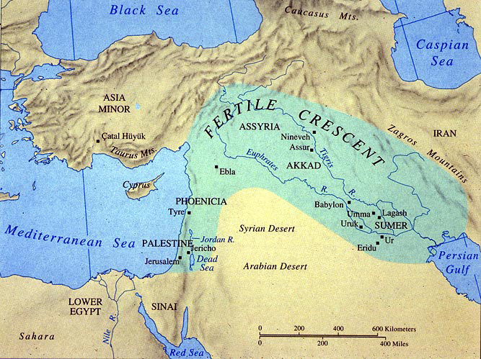

Slide 23
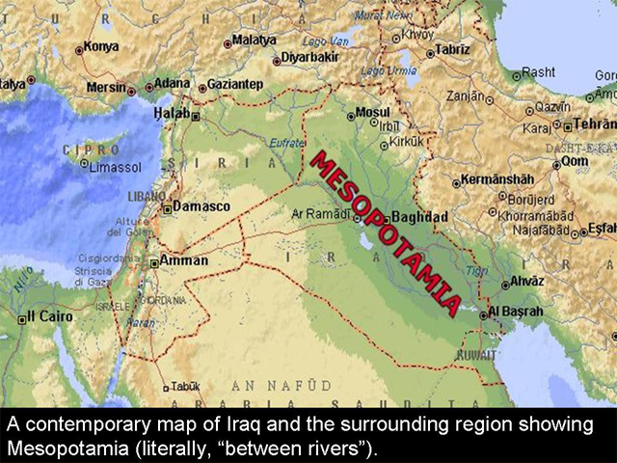

Slide 24
^{66:3.2} ^{(743.3)} The climate and landscape in the Mesopotamia of those times were in every way favorable to the undertakings of the Prince's staff and their assistants, very different from conditions which have sometimes since prevailed. It was necessary to have such a favoring climate as a part of the natural environment designed to induce primitive Urantians to make certain initial advances in culture and civilization. The one great task of those ages was to transform man from a hunter to a herder, with the hope that later on he would evolve into a peace-loving, home-abiding farmer.

Slide 25
^{66:3.3} ^{(743.4)} The headquarters of the Planetary Prince on Urantia was typical of such stations on a young and developing sphere. The nucleus of the Prince's settlement was a very simple but beautiful city, enclosed within a wall forty feet high. This world center of culture was named Dalamatia in honor of Daligastia.

Slide 26
^{66:3.4} ^{(743.5)} The city was laid out in ten subdivisions with the headquarters mansions of the ten councils of the corporeal staff situated at the centers of these subdivisions. Centermost in the city was the temple of the unseen Father. The administrative headquarters of the Prince and his associates was arranged in twelve chambers immediately grouped about the temple itself.

Slide 27
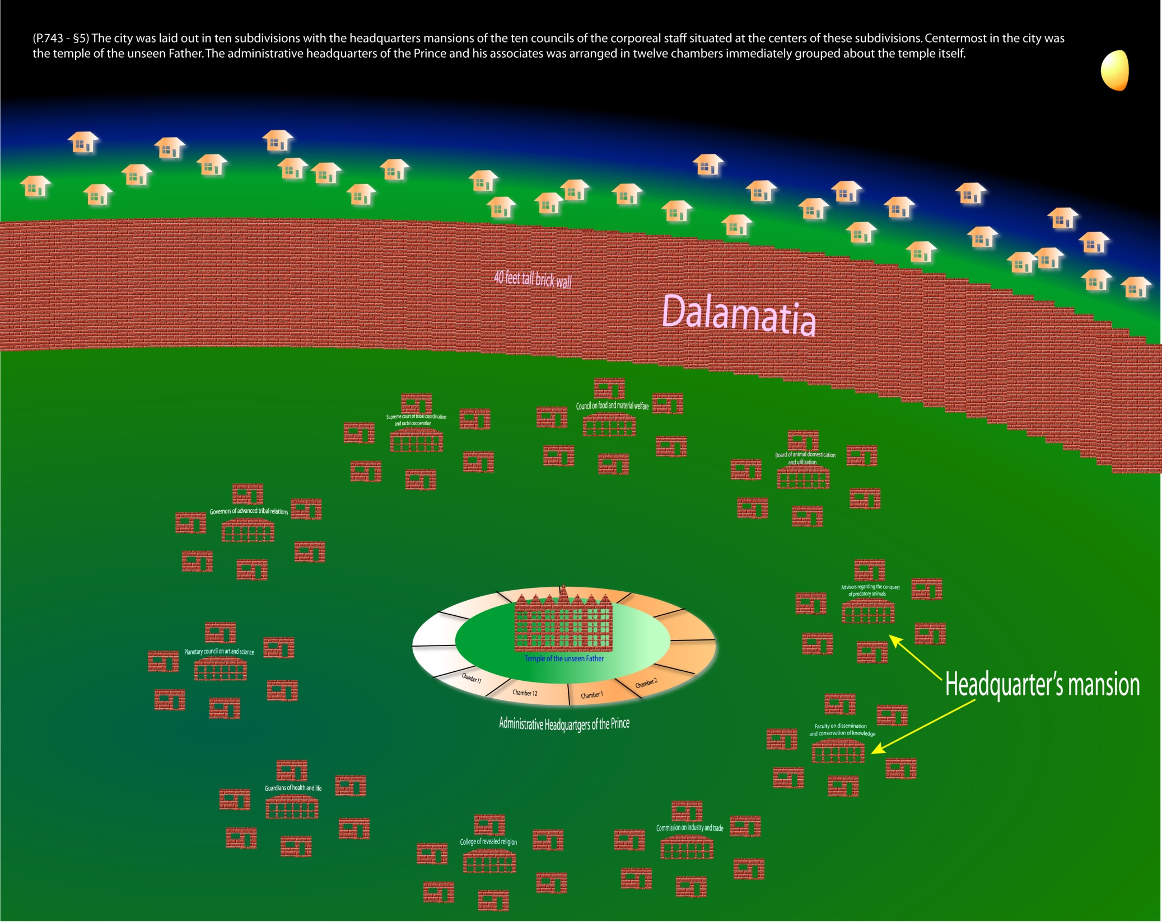
Notes:
Near the Prince's headquarters there dwelt all colors and strata of human beings. (p.743)

Slide 28
^{66:3.5} ^{(743.6)} The buildings of Dalamatia were all one story except the council headquarters, which were two stories, and the central temple of the Father of all, which was small but three stories in height.

Slide 29
^{66:3.6} ^{(743.7)} The city represented the best practices of those early days in building material—brick. Very little stone or wood was used. Home building and village architecture among the surrounding peoples were greatly improved by the Dalamatian example.

Slide 30
^{66:3.7} ^{(743.8)} Near the Prince's headquarters there dwelt all colors and strata of human beings. And it was from these near-by tribes that the first students of the Prince's schools were recruited. Although these early schools of Dalamatia were crude, they provided all that could be done for the men and women of that primitive age.

Slide 31
^{66:3.8} ^{(743.9)} The Prince's corporeal staff continuously gathered about them the superior individuals of the surrounding tribes and, after training and inspiring these students, sent them back as teachers and leaders of their respective peoples.

Slide 32
4. Early Days of the One Hundred Audio Version
^{66:4.1} ^{(743.10)} The arrival of the Prince's staff created a profound impression. While it required almost a thousand years for the news to spread abroad, those tribes near the Mesopotamian headquarters were tremendously influenced by the teachings and conduct of the one hundred new sojourners on Urantia. And much of your subsequent mythology grew out of the garbled legends of these early days when these members of the Prince's staff were repersonalized on Urantia as supermen.

Slide 33
^{66:4.2} ^{(744.1)} The serious obstacle to the good influence of such extraplanetary teachers is the tendency of mortals to regard them as gods, but aside from the technique of their appearance on earth the Caligastia one hundred—fifty men and fifty women—did not resort to supernatural methods nor superhuman manipulations.

Slide 34
^{66:4.3} ^{(744.2)} But the corporeal staff were nonetheless superhuman. They began their mission on Urantia as extraordinary threefold beings:

Slide 35
^{66:4.4} ^{(744.3)} 1. They were corporeal and relatively human, for they embodied the actual life plasm of one of the human races, the Andonic life plasm of Urantia.

Slide 36
^{66:4.5} ^{(744.4)} These one hundred members of the Prince's staff were divided equally as to sex and in accordance with their previous mortal status. Each person of this group was capable of becoming coparental to some new order of physical being, but they had been carefully instructed to resort to parenthood only under certain conditions. It is customary for the corporeal staff of a Planetary Prince to procreate their successors sometime prior to retiring from special planetary service. Usually this is at, or shortly after, the time of the arrival of the Planetary Adam and Eve.

Slide 37
^{66:4.6} ^{(744.5)} These special beings therefore had little or no idea as to what type of material creature would be produced by their sexual union. And they never did know; before the time for such a step in the prosecution of their world work the entire regime was upset by rebellion, and those who later functioned in the parental role had been isolated from the life currents of the system.

Slide 38
^{66:4.7} ^{(744.6)} In skin color and language these materialized members of Caligastia' s staff followed the Andonic race. They partook of food as did the mortals of the realm with this difference: The re-created bodies of this group were fully satisfied by a nonflesh diet. This was one of the considerations which determined their residence in a warm region abounding in fruits and nuts. The practice of subsisting on a nonflesh diet dates from the times of the Caligastia one hundred, for this custom spread near and far to affect the eating habits of many surrounding tribes, groups of origin in the once exclusively meat-eating evolutionary races.

Slide 39
^{66:4.8} ^{(744.7)} 2. The one hundred were material but superhuman beings, having been reconstituted on Urantia as unique men and women of a high and special order.

Slide 40
^{66:4.9} ^{(744.8)} This group, while enjoying provisional citizenship on Jerusem, were as yet unfused with their Thought Adjusters; and when they volunteered and were accepted for planetary service in liaison with the descending orders of sonship, their Adjusters were detached. But these Jerusemites were superhuman beings—they possessed souls of ascendant growth. During the mortal life in the flesh the soul is of embryonic estate; it is born (resurrected) in the morontia life and experiences growth through the successive morontia worlds. And the souls of the Caligastia one hundred had thus expanded through the progressive experiences of the seven mansion worlds to citizenship status on Jerusem.

Slide 41
^{66:4.10} ^{(744.9)} In conformity to their instructions the staff did not engage in sexual reproduction, but they did painstakingly study their personal constitutions, and they carefully explored every imaginable phase of intellectual (mind) and morontia (soul) liaison. And it was during the thirty-third year of their sojourn in Dalamatia, long before the wall was completed, that number two and number seven of the Danite group accidentally discovered a phenomenon attendant upon the liaison of their morontia selves (supposedly nonsexual and nonmaterial); and the result of this adventure proved to be the first of the primary midway creatures. This new being was wholly visible to the planetary staff and to their celestial associates but was not visible to the men and women of the various human tribes. Upon authority of the Planetary Prince the entire corporeal staff undertook the production of similar beings, and all were successful, following the instructions of the pioneer Danite pair. Thus did the Prince's staff eventually bring into being the original corps of 50,000 primary midwayers.

Slide 42
^{66:4.11} ^{(745.1)} These mid-type creatures were of great service in carrying on the affairs of the world's headquarters. They were invisible to human beings, but the primitive sojourners at Dalamatia were taught about these unseen semispirits, and for ages they constituted the sum total of the spirit world to these evolving mortals.

Slide 43
^{66:4.12} ^{(745.2)} 3. The Caligastia one hundred were personally immortal, or undying. There circulated through their material forms the antidotal complements of the life currents of the system; and had they not lost contact with the life circuits through rebellion, they would have lived on indefinitely until the arrival of a subsequent Son of God, or until their sometime later release to resume the interrupted journey to Havona and Paradise.

Slide 44
^{66:4.13} ^{(745.3)} These antidotal complements of the Satania life currents were derived from the fruit of the tree of life, a shrub of Edentia which was sent to Urantia by the Most Highs of Norlatiadek at the time of Caligastia's arrival. In the days of Dalamatia this tree grew in the central courtyard of the temple of the unseen Father, and it was the fruit of the tree of life that enabled the material and otherwise mortal beings of the Prince's staff to live on indefinitely as long as they had access to it.

Slide 45
^{66:4.14} ^{(745.4)} While of no value to the evolutionary races, this supersustenance was quite sufficient to confer continuous life upon the Caligastia one hundred and also upon the one hundred modified Andonites who were associated with them.

Slide 46
^{66:4.15} ^{(745.5)} It should be explained in this connection that, at the time the one hundred Andonites contributed their human germ plasm to the members of the Prince's staff, the Life Carriers introduced into their mortal bodies the complement of the system circuits; and thus were they enabled to live on concurrently with the staff, century after century, in defiance of physical death.

Slide 47
^{66:4.16} ^{(745.6)} Eventually the one hundred Andonites were made aware of their contribution to the new forms of their superiors, and these same one hundred children of the Andon tribes were kept at headquarters as the personal attendants of the Prince's corporeal staff.

Slide 48
5. Organization of the One Hundred Audio Version
^{66:5.1} ^{(745.7)} The one hundred were organized for service in ten autonomous councils of ten members each. When two or more of these ten councils met in joint session, such liaison gatherings were presided over by Daligastia. These ten groups were constituted as follows:

Slide 49
^{66:5.2} ^{(745.8)} 1. The council on food and material welfare. This group was presided over by Ang. Food, water, clothes, and the material advancement of the human species were fostered by this able corps. They taught well digging, spring control, and irrigation. They taught those from the higher altitudes and from the north improved methods of treating skins for use as clothing, and weaving was later introduced by the teachers of art and science.

Slide 50
Notes:
(Not every group included five men and five women. All leaders are assumed to be men.)
P.745 - §8 1. The council on food and material welfare. This group was presided over by Ang. Food, water, clothes, and the material advancement of the human species were fostered by this able corps. They taught well digging, spring control, and irrigation. They taught those from the higher altitudes and from the north P.746 - §0 improved methods of treating skins for use as clothing, and weaving was later introduced by the teachers of art and science.

Slide 51
^{66:5.3} ^{(746.1)} Great advances were made in methods of food storage. Food was preserved by cooking, drying, and smoking; it thus became the earliest property. Man was taught to provide for the hazards of famine, which periodically decimated the world.

Slide 52
^{66:5.4} ^{(746.2)} 2. The board of animal domestication and utilization. This council was dedicated to the task of selecting and breeding those animals best adapted to help human beings in bearing burdens and transporting themselves, to supply food, and later on to be of service in the cultivation of the soil. This able corps was directed by Bon.

Slide 53
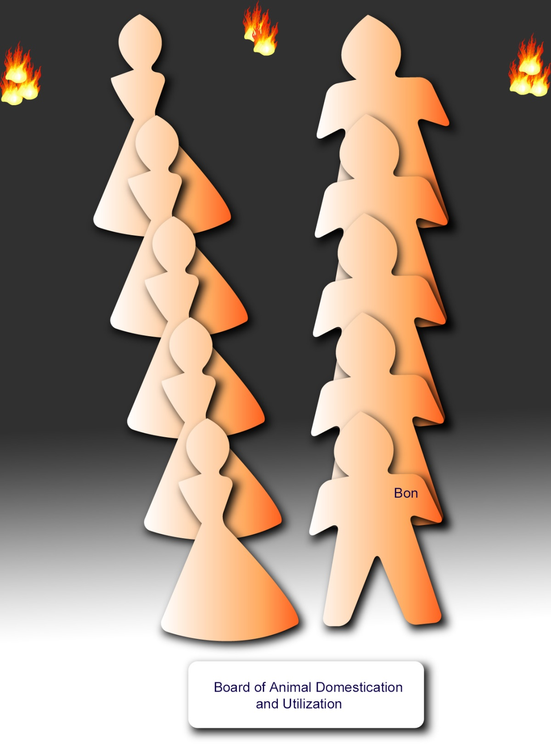
Notes:
P.746 - §2 2. The board of animal domestication and utilization. This council was dedicated to the task of selecting and breeding those animals best adapted to help human beings in bearing burdens and transporting themselves, to supply food, and later on to be of service in the cultivation of the soil. This able corps was directed by Bon.

Slide 54
^{66:5.5} ^{(746.3)} Several types of useful animals, now extinct, were tamed, together with some that have continued as domesticated animals to the present day. Man had long lived with the dog, and the blue man had already been successful in taming the elephant. The cow was so improved by careful breeding as to become a valuable source of food; butter and cheese became common articles of human diet. Men were taught to use oxen for burden bearing, but the horse was not domesticated until a later date. The members of this corps first taught men to use the wheel for the facilitation of traction.

Slide 55
^{66:5.6} ^{(746.4)} It was in these days that carrier pigeons were first used, being taken on long journeys for the purpose of sending messages or calls for help. Bon's group were successful in training the great fandors as passenger birds, but they became extinct more than thirty thousand years ago.

Slide 56
^{66:5.7} ^{(746.5)} 3. The advisers regarding the conquest of predatory animals. It was not enough that early man should try to domesticate certain animals, but he must also learn how to protect himself from destruction by the remainder of the hostile animal world. This group was captained by Dan.

Slide 57
Notes:
P.746 - §5 3. The advisers regarding the conquest of predatory animals. It was not enough that early man should try to domesticate certain animals, but he must also learn how to protect himself from destruction by the remainder of the hostile animal world. This group was captained by Dan.

Slide 58
^{66:5.8} ^{(746.6)} The purpose of an ancient city wall was to protect against ferocious beasts as well as to prevent surprise attacks by hostile humans. Those living without the walls and in the forest were dependent on tree dwellings, stone huts, and the maintenance of night fires. It was therefore very natural that these teachers should devote much time to instructing their pupils in the improvement of human dwellings. By employing improved techniques and by the use of traps, great progress was made in animal subjugation.

Slide 59
^{66:5.9} ^{(746.7)} 4. The faculty on dissemination and conservation of knowledge. This group organized and directed the purely educational endeavors of those early ages. It was presided over by Fad. The educational methods of Fad consisted in supervision of employment accompanied by instruction in improved methods of labor. Fad formulated the first alphabet and introduced a writing system. This alphabet contained twenty-five characters. For writing material these early peoples utilized tree barks, clay tablets, stone slabs, a form of parchment made of hammered hides, and a crude form of paperlike material made from wasps' nests. The Dalamatia library, destroyed soon after the Caligastia disaffection, comprised more than two million separate records and was known as the " house of Fad. "

Slide 60
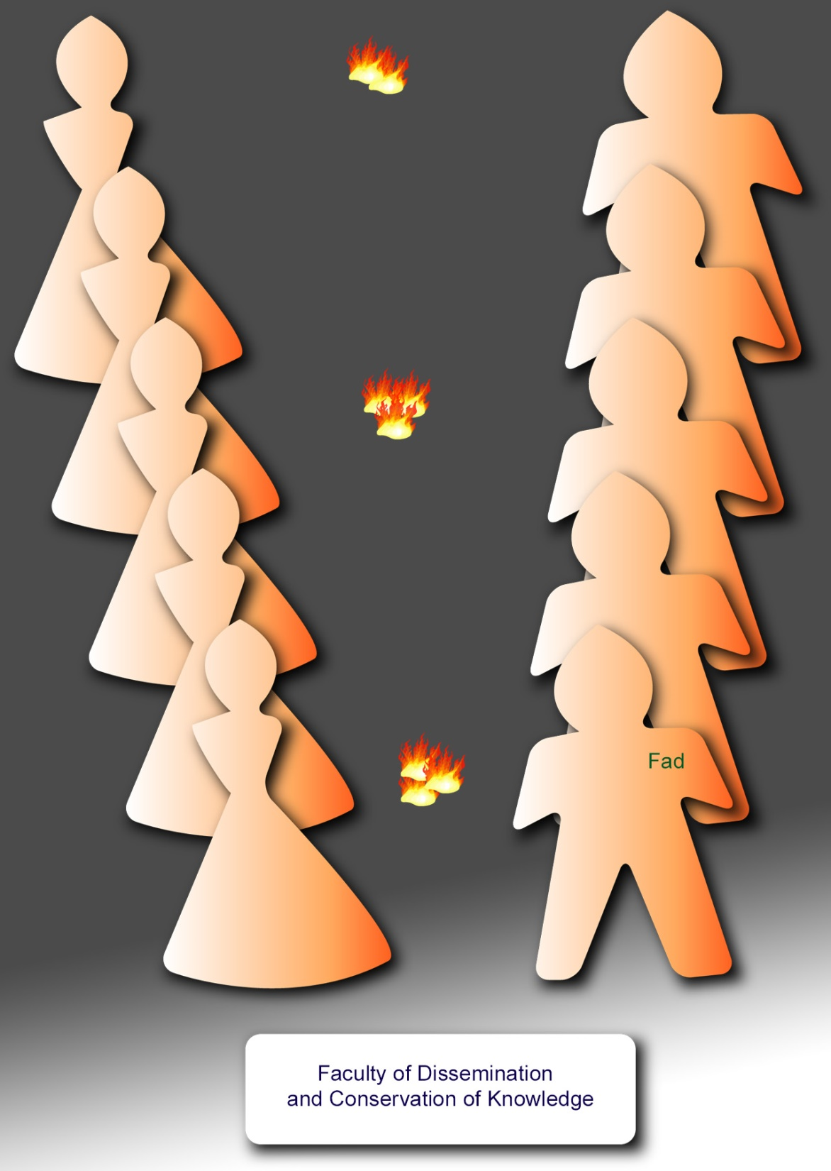
Notes:
P.746 - §7 4. The faculty on dissemination and conservation of knowledge. This group organized and directed the purely educational endeavors of those early ages. It was presided over by Fad. The educational methods of Fad consisted in supervision of employment accompanied by instruction in improved methods of labor. Fad formulated the first alphabet and introduced a writing system. This alphabet contained twenty-five characters. For writing material these early peoples utilized tree barks, clay tablets, stone slabs, a form of parchment made of hammered hides, and a crude form of paperlike material made from wasps' nests. The Dalamatia library, destroyed soon after the Caligastia disaffection, comprised more than two million separate records and was known as the "house of Fad."

Slide 61
^{66:5.10} ^{(746.8)} The blue man was partial to alphabet writing and made the greatest progress along such lines. The red man preferred pictorial writing, while the yellow races drifted into the use of symbols for words and ideas, much like those they now employ. But the alphabet and much more was subsequently lost to the world during the confusion attendant upon rebellion. The Caligastia defection destroyed the hope of the world for a universal language, at least for untold ages.

Slide 62
^{66:5.11} ^{(747.1)} 5. The commission on industry and trade. This council was employed in fostering industry within the tribes and in promoting trade between the various peace groups. Its leader was Nod. Every form of primitive manufacture was encouraged by this corps. They contributed directly to the elevation of standards of living by providing many new commodities to attract the fancy of primitive men. They greatly expanded the trade in the improved salt produced by the council on science and art.

Slide 63
Notes:
P.747 - §1 5. The commission on industry and trade. This council was employed in fostering industry within the tribes and in promoting trade between the various peace groups. Its leader was Nod. Every form of primitive manufacture was encouraged by this corps. They contributed directly to the elevation of standards of living by providing many new commodities to attract the fancy of primitive men. They greatly expanded the trade in the improved salt produced by the council on science and art.

Slide 64
^{66:5.12} ^{(747.2)} It was among these enlightened groups educated in the Dalamatia schools that the first commercial credit was practiced. From a central exchange of credits they secured tokens which were accepted in lieu of the actual objects of barter. The world did not improve upon these business methods for hundreds of thousands of years.

Slide 65
^{66:5.13} ^{(747.3)} 6. The college of revealed religion. This body was slow in functioning. Urantia civilization was literally forged out between the anvil of necessity and the hammers of fear. But this group had made considerable progress in their attempt to substitute Creator fear for creature fear (ghost worship) before their labors were interrupted by the later confusion attendant upon the secession upheaval. The head of this council was Hap.

Slide 66
Notes:
P.747 - §3 6. The college of revealed religion. This body was slow in functioning. Urantia civilization was literally forged out between the anvil of necessity and the hammers of fear. But this group had made considerable progress in their attempt to substitute Creator fear for creature fear (ghost worship) before their labors were interrupted by the later confusion attendant upon the secession upheaval. The head of this council was Hap.

Slide 67
^{66:5.14} ^{(747.4)} None of the Prince's staff would present revelation to complicate evolution; they presented revelation only as the climax of their exhaustion of the forces of evolution. But Hap did yield to the desire of the inhabitants of the city for the establishment of a form of religious service. His group provided the Dalamatians with the seven chants of worship and also gave them the daily praise-phrase and eventually taught them " the Father's prayer, " which was:

Slide 68
^{66:5.15} ^{(747.5)} " Father of all, whose Son we honor, look down upon us with favor. Deliver us from the fear of all save you. Make us a pleasure to our divine teachers and forever put truth on our lips. Deliver us from violence and anger; give us respect for our elders and that which belongs to our neighbors. Give us this season green pastures and fruitful flocks to gladden our hearts. We pray for the hastening of the coming of the promised uplifter, and we would do your will on this world as others do on worlds beyond. "

Slide 69
^{66:5.16} ^{(747.6)} Although the Prince's staff were limited to natural means and ordinary methods of race improvement, they held out the promise of the Adamic gift of a new race as the goal of subsequent evolutionary growth upon the attainment of the height of biologic development.

Slide 70
^{66:5.17} ^{(747.7)} 7. The guardians of health and life. This council was concerned with the introduction of sanitation and the promotion of primitive hygiene and was led by Lut.

Slide 71
Notes:
P.747 - §7 7. The guardians of health and life. This council was concerned with the introduction of sanitation and the promotion of primitive hygiene and was led by Lut.

Slide 72
^{66:5.18} ^{(747.8)} Its members taught much that was lost during the confusion of subsequent ages, never to be rediscovered until the twentieth century. They taught mankind that cooking, boiling and roasting, was a means of avoiding sickness; also that such cooking greatly reduced infant mortality and facilitated early weaning.

Slide 73
^{66:5.19} ^{(747.9)} Many of the early teachings of Lut's guardians of health persisted among the tribes of earth on down to the days of Moses, even though they became much garbled and were greatly changed.

Slide 74
^{66:5.20} ^{(748.1)} The great obstacle in the way of promoting hygiene among these ignorant peoples consisted in the fact that the real causes of many diseases were too small to be seen by the naked eye, and also because they all held fire in superstitious regard. It required thousands of years to persuade them to burn refuse. In the meantime they were urged to bury their decaying rubbish. The great sanitary advance of this epoch came from the dissemination of knowledge regarding the health-giving and disease-destroying properties of sunlight.

Slide 75
^{66:5.21} ^{(748.2)} Before the Prince's arrival, bathing had been an exclusively religious ceremonial. It was indeed difficult to persuade primitive men to wash their bodies as a health practice. Lut finally induced the religious teachers to include cleansing with water as a part of the purification ceremonies to be practiced in connection with the noontime devotions, once a week, in the worship of the Father of all.

Slide 76
^{66:5.22} ^{(748.3)} These guardians of health also sought to introduce handshaking in substitution for saliva exchange or blood drinking as a seal of personal friendship and as a token of group loyalty. But when out from under the compelling pressure of the teachings of their superior leaders, these primitive peoples were not slow in reverting to their former health-destroying and disease-breeding practices of ignorance and superstition.

Slide 77
^{66:5.23} ^{(748.4)} 8. The planetary council on art and science. This corps did much to improve the industrial technique of early man and to elevate his concepts of beauty. Their leader was Mek.

Slide 78
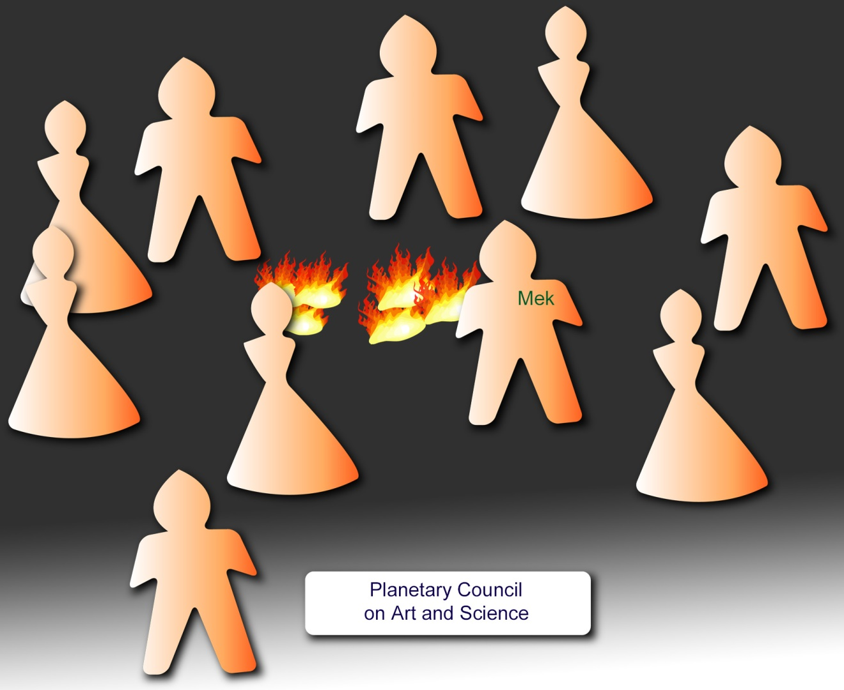
Notes:
P.748 - §4 8. The planetary council on art and science. This corps did much to improve the industrial technique of early man and to elevate his concepts of beauty. Their leader was Mek.

Slide 79
^{66:5.24} ^{(748.5)} Art and science were at a low ebb throughout the world, but the rudiments of physics and chemistry were taught the Dalamatians. Pottery was advanced, decorative arts were all improved, and the ideals of human beauty were greatly enhanced. But music made little progress until after the arrival of the violet race.

Slide 80
^{66:5.25} ^{(748.6)} These primitive men would not consent to experiment with steam power, notwithstanding the repeated urgings of their teachers; never could they overcome their great fear of the explosive power of confined steam. They were, however, finally persuaded to work with metals and fire, although a piece of red-hot metal was a terrorizing object to early man.

Slide 81
^{66:5.26} ^{(748.7)} Mek did a great deal to advance the culture of the Andonites and to improve the art of the blue man. A blend of the blue man with the Andon stock produced an artistically gifted type, and many of them became master sculptors. They did not work in stone or marble, but their works of clay, hardened by baking, adorned the gardens of Dalamatia.

Slide 82
^{66:5.27} ^{(748.8)} Great progress was made in the home arts, most of which were lost in the long and dark ages of rebellion, never to be rediscovered until modern times.

Slide 83
^{66:5.28} ^{(748.9)} 9. The governors of advanced tribal relations. This was the group intrusted with the work of bringing human society up to the level of statehood. Their chief was Tut.

Slide 84
Notes:
P.748 - §9 9. The governors of advanced tribal relations. This was the group intrusted with the work of bringing human society up to the level of statehood. Their chief was Tut.

Slide 85
^{66:5.29} ^{(748.10)} These leaders contributed much to bringing about intertribal marriages. They fostered courtship and marriage after due deliberation and full opportunity to become acquainted. The purely military war dances were refined and made to serve valuable social ends. Many competitive games were introduced, but these ancient folk were a serious people; little humor graced these early tribes. Few of these practices survived the subsequent disintegration of planetary insurrection.

Slide 86
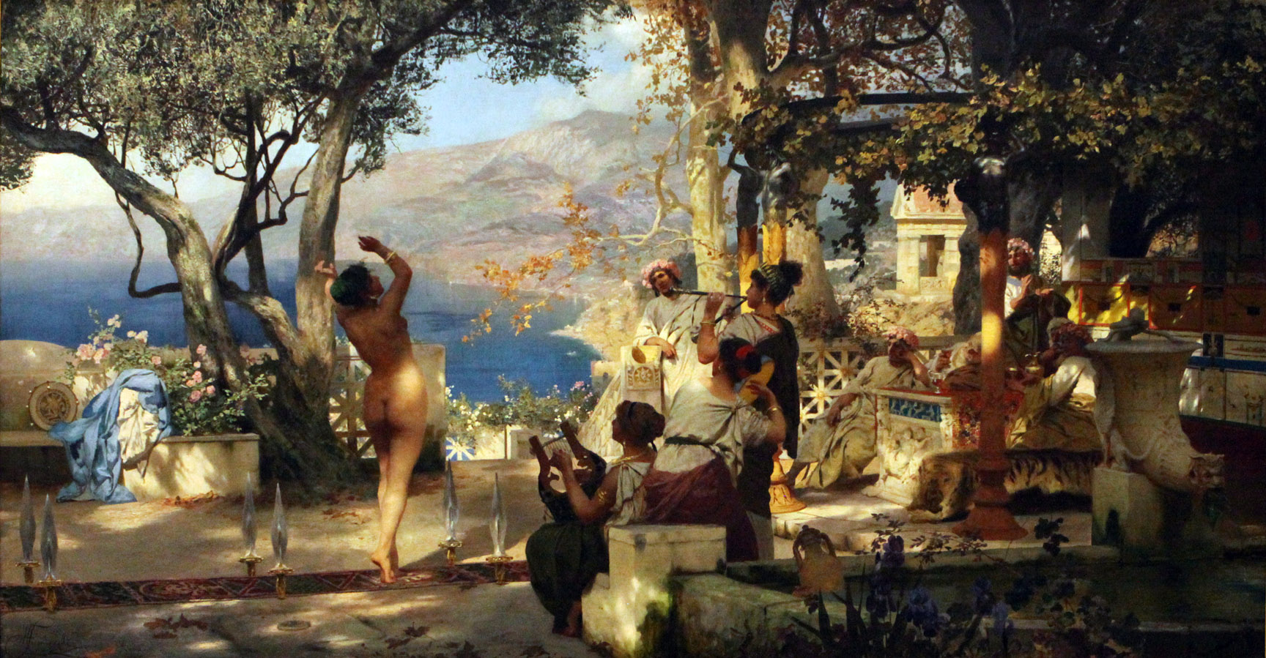
military war dances (p.748)

Slide 87
^{66:5.30} ^{(749.1)} Tut and his associates labored to promote group associations of a peaceful nature, to regulate and humanize warfare, to co-ordinate intertribal relations, and to improve tribal governments. In the vicinity of Dalamatia there developed a more advanced culture, and these improved social relations were very helpful in influencing more remote tribes. But the pattern of civilization prevailing at the Prince's headquarters was quite different from the barbaric society evolving elsewhere, just as the twentieth-century society of Capetown, South Africa, is totally unlike the crude culture of the diminutive Bushmen to the north.

Slide 88
^{66:5.31} ^{(749.2)} 10. The supreme court of tribal co-ordination and racial co-operation. This supreme council was directed by Van and was the court of appeals for all of the other nine special commissions charged with the supervision of human affairs. This council was one of wide function, being intrusted with all matters of earthly concern which were not specifically assigned to the other groups. This selected corps had been approved by the Constellation Fathers of Edentia before they were authorized to assume the functions of the supreme court of Urantia.

Slide 89
Notes:
P.749 - §2 10. The supreme court of tribal co-ordination and racial co-operation. This supreme council was directed by Van and was the court of appeals for all of the other nine special commissions charged with the supervision of human affairs. This council was one of wide function, being intrusted with all matters of earthly concern which were not specifically assigned to the other groups. This selected corps had been approved by the Constellation Fathers of Edentia before they were authorized to assume the functions of the supreme court of Urantia.

Slide 90
6. The Prince’s Reign Audio Version
^{66:6.1} ^{(749.3)} The degree of a world's culture is measured by the social heritage of its native beings, and the rate of cultural expansion is wholly determined by the ability of its inhabitants to comprehend new and advanced ideas.

Slide 91
^{66:6.2} ^{(749.4)} Slavery to tradition produces stability and co-operation by sentimentally linking the past with the present, but it likewise stifles initiative and enslaves the creative powers of the personality. The whole world was caught in the stalemate of tradition-bound mores when the Caligastia one hundred arrived and began the proclamation of the new gospel of individual initiative within the social groups of that day. But this beneficent rule was so soon interrupted that the races never have been wholly liberated from the slavery of custom; fashion still unduly dominates Urantia.

Slide 92
^{66:6.3} ^{(749.5)} The Caligastia one hundred—graduates of the Satania mansion worlds—well knew the arts and culture of Jerusem, but such knowledge is nearly valueless on a barbaric planet populated by primitive humans. These wise beings knew better than to undertake the sudden transformation, or the en masse uplifting, of the primitive races of that day. They well understood the slow evolution of the human species, and they wisely refrained from any radical attempts at modifying man's mode of life on earth.

Slide 93
^{66:6.4} ^{(749.6)} Each of the ten planetary commissions set about slowly and naturally to advance the interests intrusted to them. Their plan consisted in attracting the best minds of the surrounding tribes and, after training them, sending them back to their people as emissaries of social uplift.

Slide 94
^{66:6.5} ^{(749.7)} Foreign emissaries were never sent to a race except upon the specific request of that people. Those who labored for the uplift and advancement of a given tribe or race were always natives of that tribe or race. The one hundred would not attempt to impose the habits and mores of even a superior race upon another tribe. Always they patiently worked to uplift and advance the time-tried mores of each race. The simple folk of Urantia brought their social customs to Dalamatia, not to exchange them for new and better practices, but to have them uplifted by contact with a higher culture and by association with superior minds. The process was slow but very effectual.

Slide 95
^{66:6.6} ^{(750.1)} The Dalamatia teachers sought to add conscious social selection to the purely natural selection of biologic evolution. They did not derange human society, but they did markedly accelerate its normal and natural evolution. Their motive was progression by evolution and not revolution by revelation. The human race had spent ages in acquiring the little religion and morals it had, and these supermen knew better than to rob mankind of these few advances by the confusion and dismay which always result when enlightened and superior beings undertake to uplift the backward races by overteaching and overenlightenment.

Slide 96
^{66:6.7} ^{(750.2)} When Christian missionaries go into the heart of Africa, where sons and daughters are supposed to remain under the control and direction of their parents throughout the lifetime of the parents, they only bring about confusion and the breakdown of all authority when they seek, in a single generation, to supplant this practice by teaching that these children should be free from all parental restraint after they have attained the age of twenty-one.

Slide 97
7. Life in Dalamatia Audio Version
^{66:7.1} ^{(750.3)} The Prince's headquarters, though exquisitely beautiful and designed to awe the primitive men of that age, was altogether modest. The buildings were not especially large as it was the motive of these imported teachers to encourage the eventual development of agriculture through the introduction of animal husbandry. The land provision within the city walls was sufficient to provide for pasturage and gardening for the support of a population of about twenty thousand.

Slide 98
^{66:7.2} ^{(750.4)} The interiors of the central temple of worship and the ten council mansions of the supervising groups of supermen were indeed beautiful works of art. And while the residential buildings were models of neatness and cleanliness, everything was very simple and altogether primitive in comparison with later-day developments. At this headquarters of culture no methods were employed which did not naturally belong on Urantia.

Slide 99
^{66:7.3} ^{(750.5)} The Prince's corporeal staff presided over simple and exemplary abodes which they maintained as homes designed to inspire and favorably impress the student observers sojourning at the world's social center and educational headquarters.

Slide 100
^{66:7.4} ^{(750.6)} The definite order of family life and the living of one family together in one residence of comparatively settled location date from these times of Dalamatia and were chiefly due to the example and teachings of the one hundred and their pupils. The home as a social unit never became a success until the supermen and superwomen of Dalamatia led mankind to love and plan for their grandchildren and their grandchildren's children. Savage man loves his child, but civilized man loves also his grandchild.

Slide 101
^{66:7.5} ^{(750.7)} The Prince's staff lived together as fathers and mothers. True, they had no children of their own, but the fifty pattern homes of Dalamatia never sheltered less than five hundred adopted little ones assembled from the superior families of the Andonic and Sangik races; many of these children were orphans. They were favored with the discipline and training of these superparents; and then, after three years in the schools of the Prince (they entered from thirteen to fifteen), they were eligible for marriage and ready to receive their commissions as emissaries of the Prince to the needy tribes of their respective races.

Slide 102
^{66:7.6} ^{(751.1)} Fad sponsored the Dalamatia plan of teaching that was carried out as an industrial school in which the pupils learned by doing, and through which they worked their way by the daily performance of useful tasks. This plan of education did not ignore thinking and feeling in the development of character; but it gave first place to manual training. The instruction was individual and collective. The pupils were taught by both men and women and by the two acting conjointly. One half of this group instruction was by sexes; the other half was coeducational. Students were taught manual dexterity as individuals and were socialized in groups or classes. They were trained to fraternize with younger groups, older groups, and adults, as well as to do teamwork with those of their own ages. They were also familiarized with such associations as family groups, play squads, and school classes.

Slide 103
^{66:7.7} ^{(751.2)} Among the later students trained in Mesopotamia for work with their respective races were Andonites from the highlands of western India together with representatives of the red men and the blue men; still later a small number of the yellow race were also received.

Slide 104
^{66:7.8} ^{(751.3)} Hap presented the early races with a moral law. This code was known as " The Father's Way " and consisted of the following seven commands:
^{66:7.9} ^{(751.4)} 1. You shall not fear nor serve any God but the Father of all.
^{66:7.10} ^{(751.5)} 2. You shall not disobey the Father's Son, the world's ruler, nor show disrespect to his superhuman associates.
^{66:7.11} ^{(751.6)} 3. You shall not speak a lie when called before the judges of the people.
^{66:7.12} ^{(751.7)} 4. You shall not kill men, women, or children.
^{66:7.13} ^{(751.8)} 5. You shall not steal your neighbor's goods or cattle.
^{66:7.14} ^{(751.9)} 6. You shall not touch your friend's wife.
^{66:7.15} ^{(751.10)} 7. You shall not show disrespect to your parents or to the elders of the tribe.

Slide 105
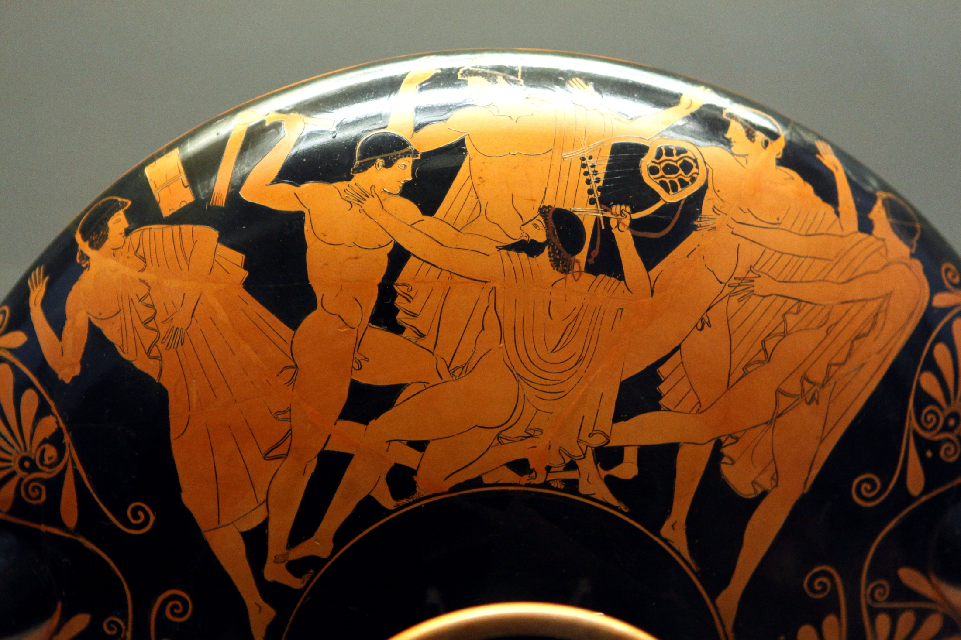
Notes:
You shall not kill men, women, or children (p.751)

Slide 106
^{66:7.16} ^{(751.11)} This was the law of Dalamatia for almost three hundred thousand years. And many of the stones on which this law was inscribed now lie beneath the waters off the shores of Mesopotamia and Persia. It became the custom to hold one of these commands in mind for each day of the week, using it for salutations and mealtime thanksgiving.

Slide 107
^{66:7.17} ^{(751.12)} The time measurement of these days was the lunar month, this period being reckoned as twenty-eight days. That, with the exception of day and night, was the only time reckoning known to the early peoples. The seven-day week was introduced by the Dalamatia teachers and grew out of the fact that seven was one fourth of twenty-eight. The significance of the number seven in the superuniverse undoubtedly afforded them opportunity to introduce a spiritual reminder into the common reckoning of time. But there is no natural origin for the weekly period.

Slide 108
^{66:7.18} ^{(751.13)} The country around the city was quite well settled within a radius of one hundred miles. Immediately surrounding the city, hundreds of graduates of the Prince's schools engaged in animal husbandry and otherwise carried out the instruction they had received from his staff and their numerous human helpers. A few engaged in agriculture and horticulture.

Slide 109
^{66:7.19} ^{(751.14)} Mankind was not consigned to agricultural toil as the penalty of supposed sin. " In the sweat of your face shall you eat the fruit of the fields " was not a sentence of punishment pronounced because of man's participation in the follies of the Lucifer rebellion under the leadership of the traitorous Caligastia. The cultivation of the soil is inherent in the establishment of an advancing civilization on the evolutionary worlds, and this injunction was the center of all teaching of the Planetary Prince and his staff throughout the three hundred thousand years which intervened between their arrival on Urantia and those tragic days when Caligastia threw in his lot with the rebel Lucifer. Work with the soil is not a curse; rather is it the highest blessing to all who are thus permitted to enjoy the most human of all human activities.

Slide 110
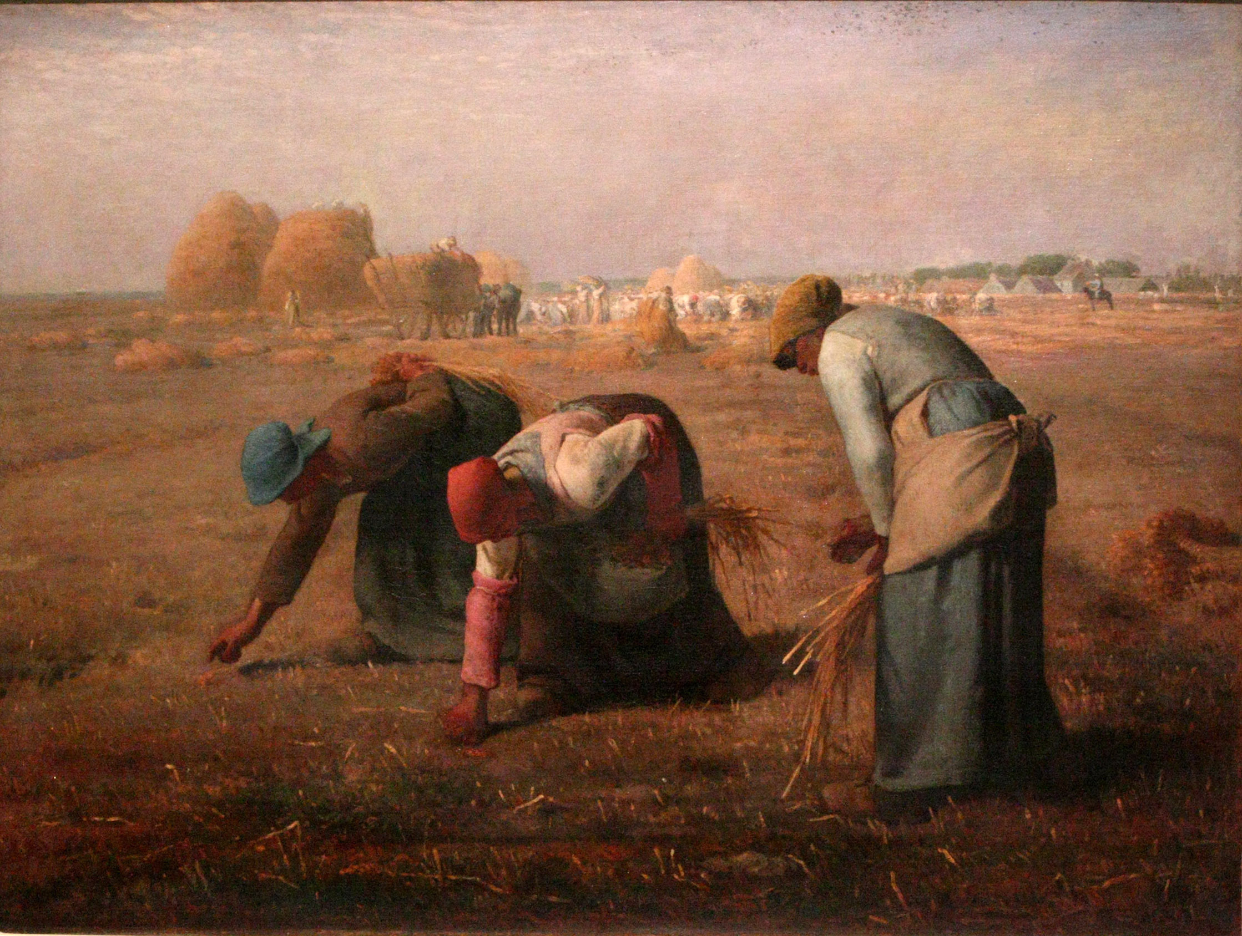
Notes:
Work with the soil is not a curse; rather is it the highest blessing to all (p.751)

Slide 111
^{66:7.20} ^{(752.1)} At the outbreak of the rebellion, Dalamatia had a resident population of almost six thousand. This number includes the regular students but does not embrace the visitors and observers, who always numbered more than one thousand. But you can have little or no concept of the marvelous progress of those faraway times; practically all of the wonderful human gains of those days were wiped out by the horrible confusion and abject spiritual darkness which followed the Caligastia catastrophe of deception and sedition.

Slide 112
8. Misfortunes of Caligastia Audio Version
^{66:8.1} ^{(752.2)} In looking back over the long career of Caligastia, we find only one outstanding feature of his conduct that might have challenged attention; he was ultraindividualistic. He was inclined to take sides with almost every party of protest, and he was usually sympathetic with those who gave mild expression to implied criticism. We detect the early appearance of this tendency to be restless under authority, to mildly resent all forms of supervision. While slightly resentful of senior counsel and somewhat restive under superior authority, nonetheless, whenever a test had come, he had always proved loyal to the universe rulers and obedient to the mandates of the Constellation Fathers. No real fault was ever found in him up to the time of his shameful betrayal of Urantia.

Slide 113
^{66:8.2} ^{(752.3)} It should be noted that both Lucifer and Caligastia had been patiently instructed and lovingly warned respecting their critical tendencies and the subtle development of their pride of self and its associated exaggeration of the feeling of self-importance. But all of these attempts to help had been misconstrued as unwarranted criticism and as unjustified interference with personal liberties. Both Caligastia and Lucifer judged their friendly advisers as being actuated by the very reprehensible motives which were beginning to dominate their own distorted thinking and misguided planning. They judged their unselfish advisers by their own evolving selfishness.

Slide 114
^{66:8.3} ^{(752.4)} From the arrival of Prince Caligastia, planetary civilization progressed in a fairly normal manner for almost three hundred thousand years. Aside from being a life-modification sphere and therefore subject to numerous irregularities and unusual episodes of evolutionary fluctuation, Urantia progressed very satisfactorily in its planetary career up to the times of the Lucifer rebellion and the concurrent Caligastia betrayal. All subsequent history has been definitely modified by this catastrophic blunder as well as by the later failure of Adam and Eve to fulfill their planetary mission.

Slide 115
^{66:8.4} ^{(752.5)} The Prince of Urantia went into darkness at the time of the Lucifer rebellion, thus precipitating the long confusion of the planet. He was subsequently deprived of sovereign authority by the co-ordinate action of the constellation rulers and other universe authorities. He shared the inevitable vicissitudes of isolated Urantia down to the time of Adam's sojourn on the planet and contributed something to the miscarriage of the plan to uplift the mortal races through the infusion of the lifeblood of the new violet race—the descendants of Adam and Eve.

Slide 116
^{66:8.5} ^{(753.1)} The power of the fallen Prince to disturb human affairs was enormously curtailed by the mortal incarnation of Machiventa Melchizedek in the days of Abraham; and subsequently, during the life of Michael in the flesh, this traitorous Prince was finally shorn of all authority on Urantia.

Slide 117
^{66:8.6} ^{(753.2)} The doctrine of a personal devil on Urantia, though it had some foundation in the planetary presence of the traitorous and iniquitous Caligastia, was nevertheless wholly fictitious in its teachings that such a " devil " could influence the normal human mind against its free and natural choosing. Even before Michael's bestowal on Urantia, neither Caligastia nor Daligastia was ever able to oppress mortals or to coerce any normal individual into doing anything against the human will. The free will of man is supreme in moral affairs; even the indwelling Thought Adjuster refuses to compel man to think a single thought or to perform a single act against the choosing of man's own will.

Slide 118
^{66:8.7} ^{(753.3)} And now this rebel of the realm, shorn of all power to harm his former subjects, awaits the final adjudication, by the Uversa Ancients of Days, of all who participated in the Lucifer rebellion.
^{66:8.8} ^{(753.4)} [Presented by a Melchizedek of Nebadon. ]

Slide 119
Paper 67 - The Planetary Rebellion

